Slide 1

FIT PRO
By Nagahemanth Murari.a

Slide 2
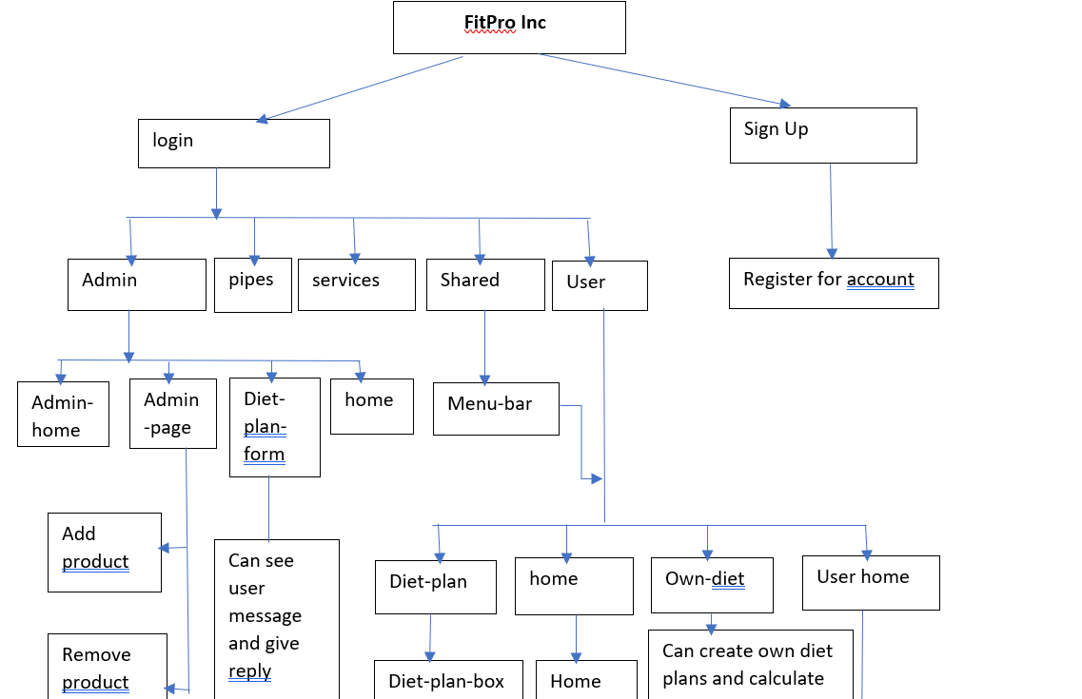
Work Flow

Slide 3

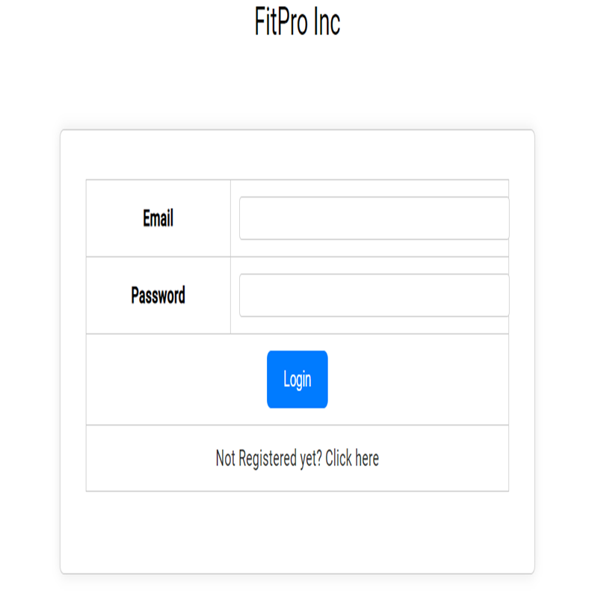



Login Page
Log in is considered as two
-User Log In
-Admin Log In
Or if there is any new user then using register here button we can register new user and give login credentials to user

Slide 4
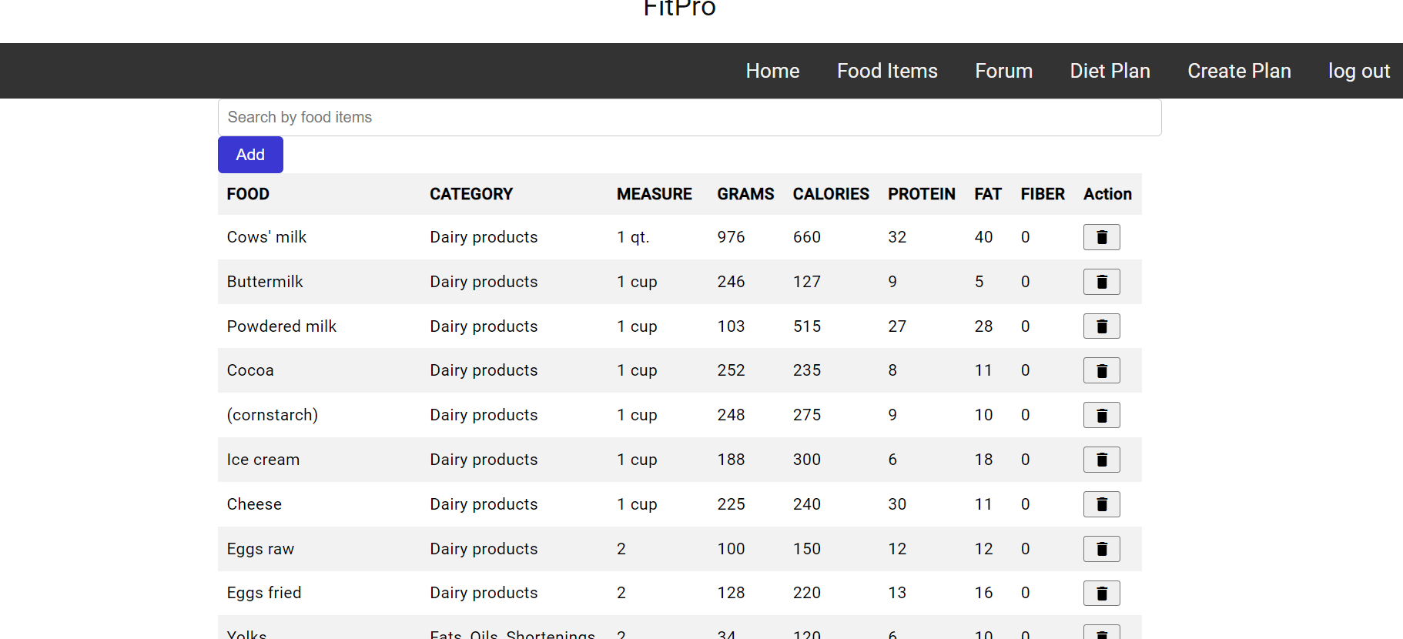
Admin’s Interface
In Admin Interface Admin can add a products and its nutrition values or delete an product as well
And admin can give reply for the messages or suggesstions or queries given by user

Slide 5
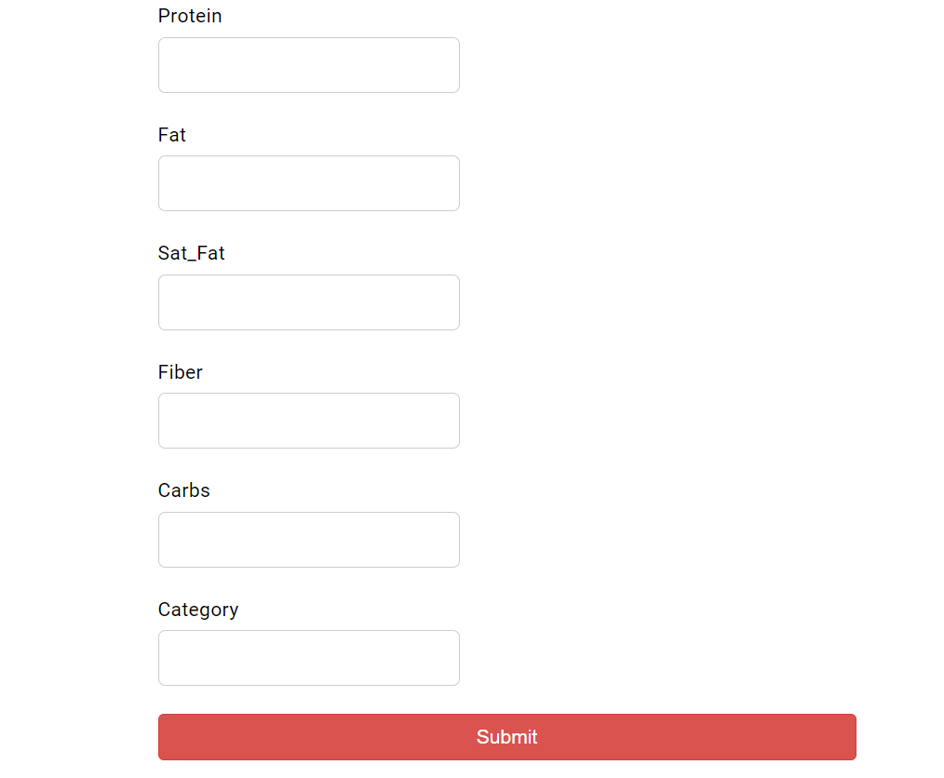
Admin Interface
If Admin wants to add any food product he have to fill all the required nutrition values and by clicking add user can add the items

Slide 6
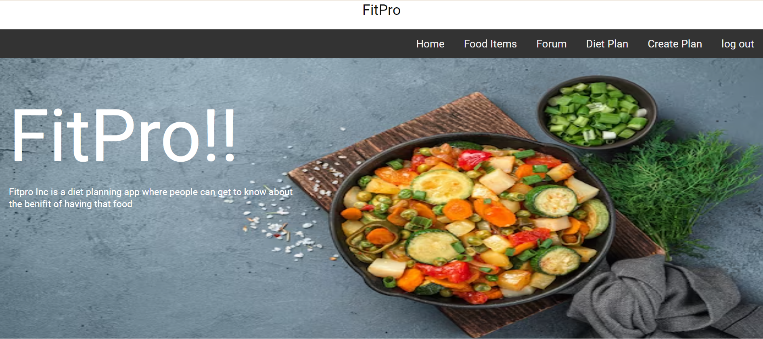
User Interface
The user has different features, the page that shows the products available its nutritional values, a forum for discussion and a page that displays multiple diet plans available and plan your own diet that calculates your whole diet calories based on the products you selected.
The user logout option and the user home button are always on display.

Slide 7
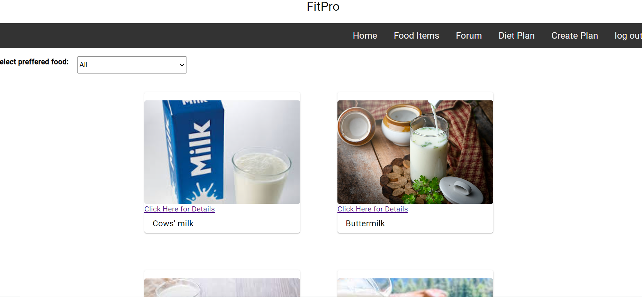
User Experience
The user can see the types of foods available for the user to have and have been not deleted by the admin.
The user has a option of selecting the category of food as well to get to the product required as soon as possible.
User can click on details and can see whats the nutrition value of that particular product

Slide 8
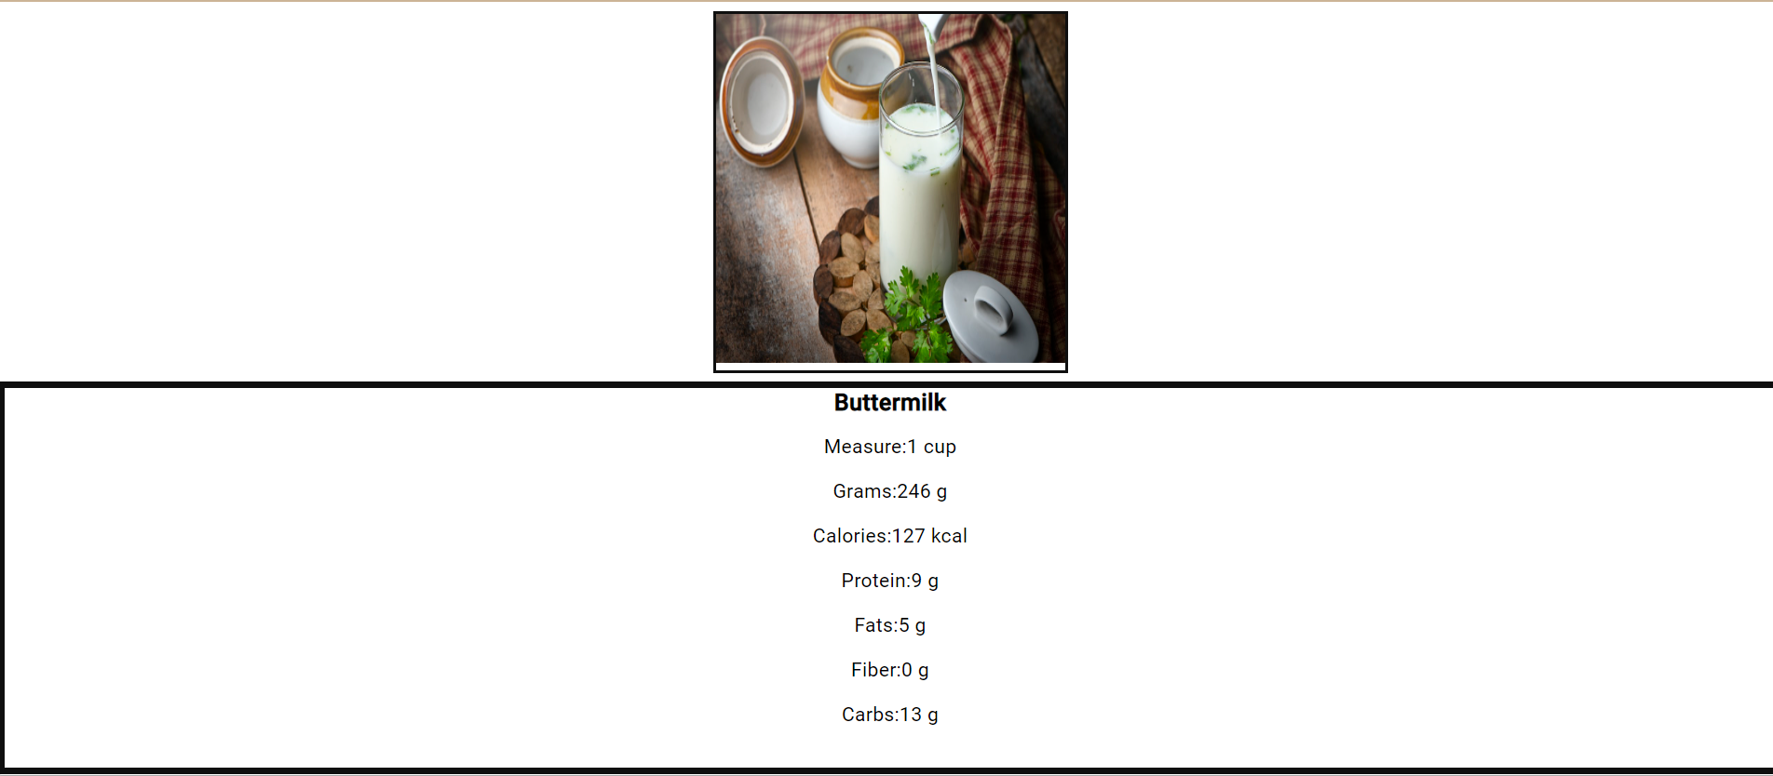
Product’s Description
The details of each product which is the total number of calories, protein and other elements present in a particular measured amount of the element is displayed.
The user can opt to reach directly to the home from this page or even log out.

Slide 9
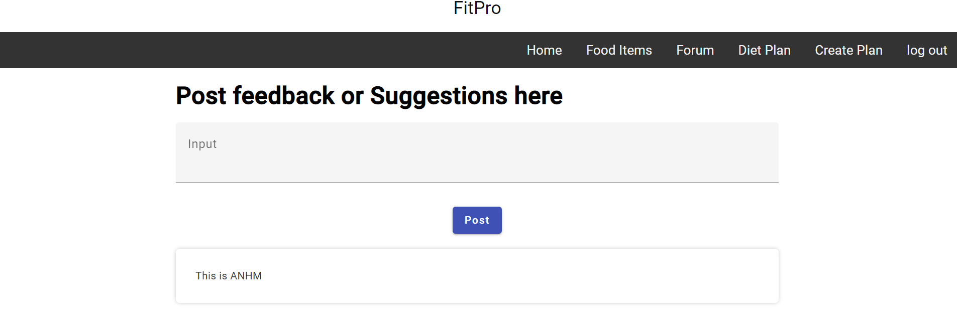
User Forum
In User Forum , User can post suggestions or feed back or queries regarding the usage of the app

Slide 10
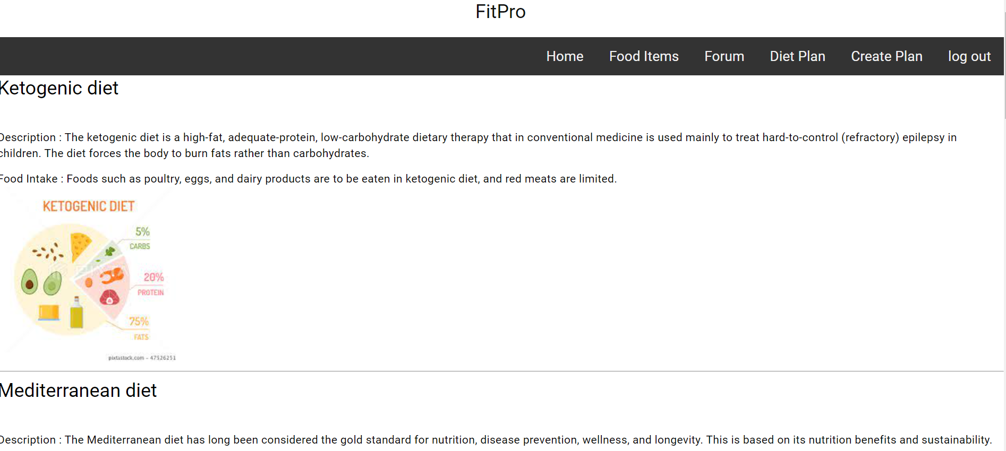
Diet Plans
There are 6 types of diets mentioned. All the 6 types of details are stored in the json file.
The details are displayed and the food items needs to take for the diets are displayed.

Slide 11
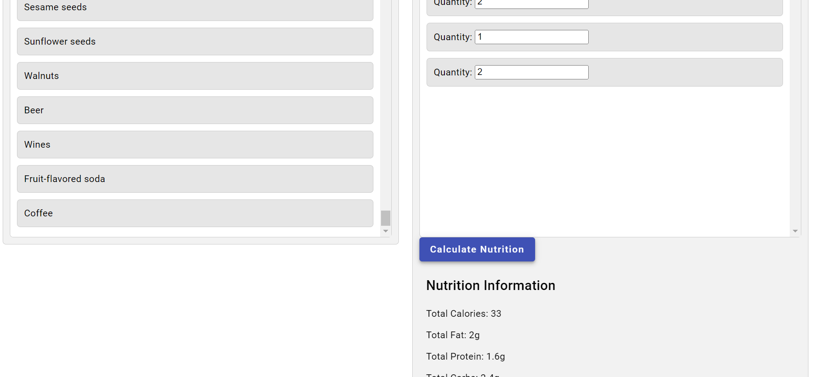
Creating user’s preferred diet plan
The user can input different types of food products from different categories and sum up all to get a required amount of calories basing which he can create his own diet.
User can pick his preferred food item and place it in the box provided and on clicking the calculate they can get to know nutrition value they get after having that food

